Slide 1




IRONHACK
Competitive Landscape
Analysis
BSG Team
Rocio Alvarez-Rementeria
Jonatan Aguilera
Irina Markova
Pablo Pazos

Slide 2

Introduction
Analytics consulting project to understand Ironhack's competitive landscape: which other coding schools are there and what drives their success or lack thereof relative to Ironhack.
Design, create and populate an appropriate database with information about coding schools and design suitable queries to answer business questions.

Slide 3
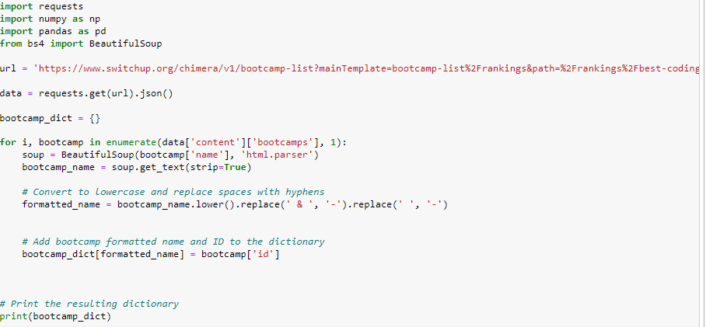
Web
Scraping
Information of 48 schools:

Slide 4
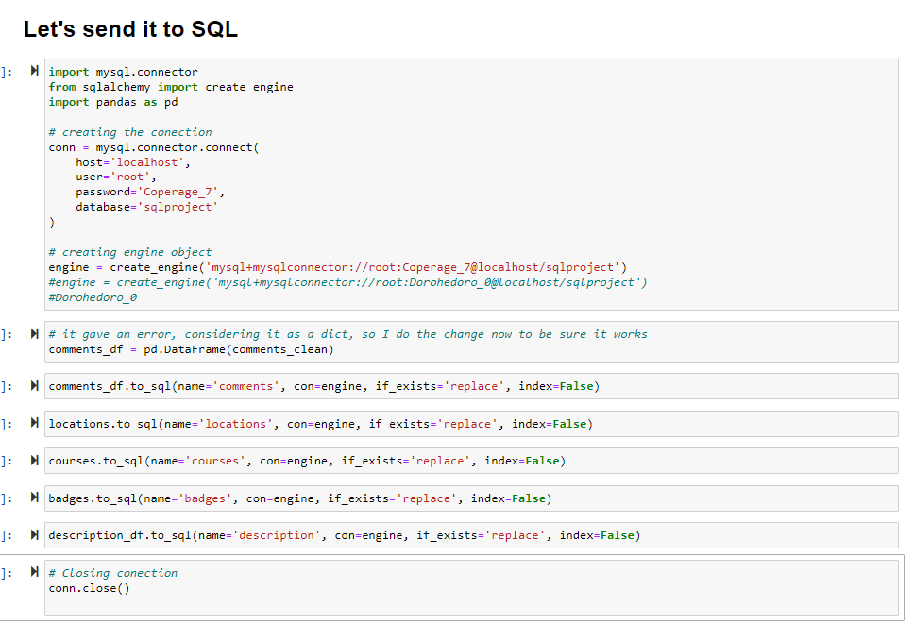
Connect to MySQL

Slide 5
MySQL Data
Cleaning
CREATE TABLE
DROP COLUMN
INSERT INTO
SET FROM WHERE
JOIN, UPDATE

Slide 6
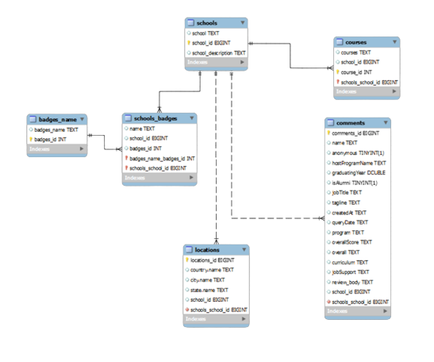
Relations
Model

Slide 7
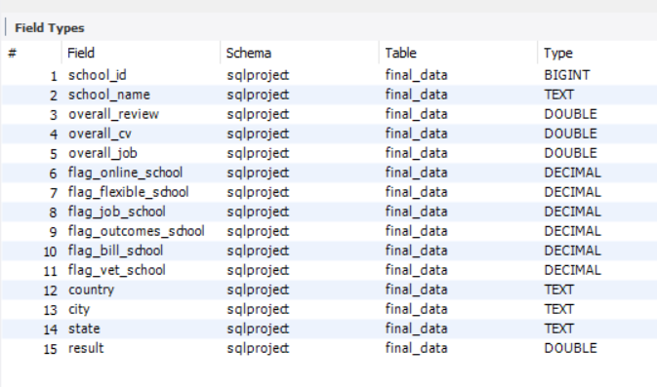
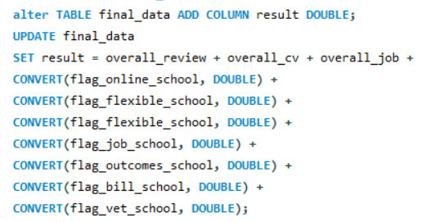
MySQL
Queries
Consolidate information of schools:
Estimate a metric to do a ranking of schools:

Slide 8
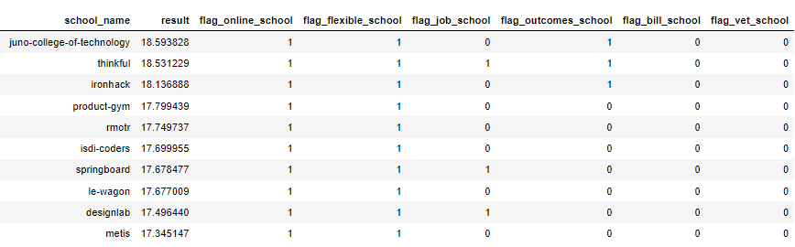
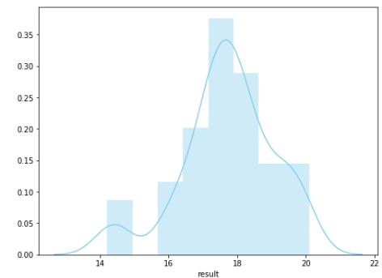
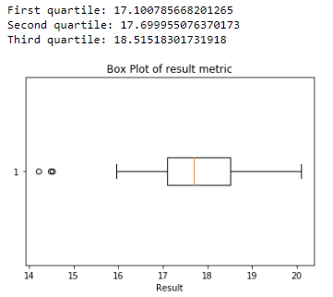
Descriptive
analysis
with
python
Final conclusions:
Synergies:
Location: United States.
Online & flexible formats available.
TOP 10 Ranking of schools not located in USA:

Slide 9
IRONHACK
Competitive Landscape
Analysis
QUESTIONS?

